Slide 1
Introduction to clinical genetics
Prof Priyantha Perera

Slide 2
What is Clinical Genetics?
Clinical Genetics is the medical specialty which provides a diagnostic service and "genetic counselling" for individuals or families with, or at risk of, conditions which may have a genetic basis.
Genetic disorders can affect any body system and any age group
The aim of Genetic Services is to help those affected by, or at risk of, a genetic disorder to live and reproduce as normally as possible.

Slide 3
Genetic disorders
Genetic disorders include :
Chromosomal abnormalities, which cause birth defects, mental retardation and/or reproductive problems.
Single gene disorders such as cystic fibrosis, muscular dystrophy, Huntington's disease and sickle cell disease.
Familial cancer and cancer-prone syndromes such as inherited breast or colorectal cancer and neurofibromatosis.
Birth defects with a genetic component such as neural tube defects and cleft lip and palate.

Slide 4
Chromosomal abnormalities
Trisomies- Down (21), Patau (13) , Edward (18), Klinefelter (XXY). Can occur due to anaphase lag causing nondisjunction, Translocations of mosacism
Monosomies – Turner (X0)
Translocations
Inversions
Duplications
Ring chromosomes

Slide 5
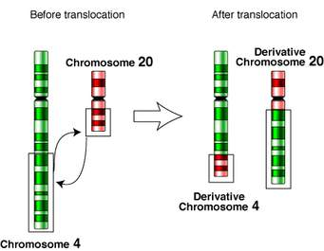
Translocations

Slide 6
Chromosomal abnormalities
Need a chromosomal analysis
A venous sample of blood is sent
Chromosomes in neutrophils are assessed
Cells are induced to multiply, and arrested during metaphase by poisoning the spindle
Cells are lysed and stained for chromosomes

Slide 7
Single gene defects
Mutation of a gene resulting in non production of a protein (Duchene muscular dystrophy) , less production of a protein (hemophilia) or production of an abnormal protein (sickle cell disease)
Can be autosomal dominant, autosomal recessive, X linked dominant, X linked recessive
Mitochondrial genes migrate to daughter cells in a different manner
Mitochondrial genes are only received from mother

Slide 8
Single gene defects
Can diagnose antenataly
Chorionic villi sampling
Amniocentesis can be used to get samples
If mutation in a parent is known the mutation in the fetus can be detected using Fish probes

Slide 9
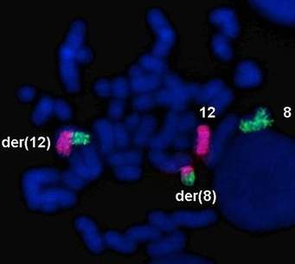
Fish probes

Slide 10
Genetics of Malignancy
Some genetic defects predispose to malignancies
Leukemia, retinoblastomas, Faccini syndrome are examples
Translocations, Deletions and chromosomal breakage syndromes are examples
Mutations in proto-oncogenes are a classic example

Slide 11
Polygenic inheritance
In these disorders there is a genetic predisposition, but its acts along with environment factors in producing disease
Examples are neural tube defects, diabetes melitus

